Slide 1
Warm Up
Name at least one task in Dreamweaver you do for every course or webpage that you wish you could automate.

Slide 2
Regular Expressions
Making Your Life Easier!
Or
How I Learned to Inadvertently Mess Up a Webpage REALLY Bad.

Slide 3
Agenda
Warm Up
Objectives
Introduction
What Are Regular Expressions?
Regex vs. Conventional Search & Replace
Examples & Demos
Questions

Slide 4
Objectives
Understand advantages of regular expression (regex or regexp) pattern matching over conventional find & replace
List regex literal characters
Differentiate among wildcards
Be able to build simple regular expressions to use in find / replace in Dreamweaver

Slide 5

Introduction
Luckiest dad in the world
Science and Engineering teacher at Lowell High School, Adjunct at Middlesex Community College
Software Engineer
US naval officer – Navigator & Nuclear Engineer
BS Computer Science, US Naval Academy
MEd UMass Lowell

Slide 6
What Are Regular Expressions?
A sequence of character (i.e., a string) that defines a search pattern
Used in find & replace utilities
Huge in Unix / Linux text processing
Used in many text editors, IDEs including Dreamweaver

Slide 7
What Are Regular Expressions?
Build search pattern strings using special or reserved characters called metacharacters:
\ ^ $ . | ? * + ( ) [ {
Similar to familiar wildcards in conventional searches (e.g., *.htm* )
Literals: Characters that match themselves, e.g.,
a abc two␣words
“Non-printable” characters: \t tab \r carriage return \n linefeed (a.k.a., newline)

Slide 8
What Are Regular Expressions?
Escaping metacharacters – Precede metacharacter with backslash (\)
\+ for plus sign \\ for backslash \\\\ for 2 backslashes
ASCII or Unicode (hexadecimal): \xA9 © \uA2 ¢
White space – Any character or series of characters representing horizontal or vertical space:
\s can represent any single space (␣), tab (\t) or newline (\n)
Any character – A powerful (or dangerous) pattern: . (period)
Matches any character except line breaks (\r, \n, \r\n)

Slide 9

What Are Regular Expressions?
Anchors: ^ for beginning of string or line, $ for end of string or line
Grouping: ( ) [ ] { }
Repetition or quantifiers – Defines optional or repeating patterns:
* zero or more times ? one or no times + one or more times {3} exactly 3 times {2,4} 2 to 4 times inclusive {5,} 5 or more times
Alternation – This or that: Pipe (|) this|that
this or that

Slide 10
Regex vs. Conventional Search & Replace
Problem: Text with too many spaces between words
Conventional Search & Replace Find: ␣␣ (or ␣␣␣, ␣␣␣␣, etc.) Replace: ␣
What is the problem with this?
Regular expression – First define the space character: ‘␣’ or \x20 Find: ␣+ or (\x20)+ or (\x20){2,} Replace: ␣ or \x20

Slide 11
Regex vs. Conventional Search & Replace
Let’s say you or someone else developed a course where all the webpages need to have the course number prepended to the filenames in that module’s allpages.html file.
getHeader('a4','sylldescript.html','body'); getHeader('a5','a_syllinstructorbio.htm','body');
Conventional search on *.htm* will find all filenames but there is no way to use replace to add the course number

Slide 12
Regex vs. Conventional Search & Replace
Hey Doug, what are those dollar sign thingies?
Regex: Find: (,')(.*\.html?',) Replace: $1metxy678_$2
getHeader('a4','metxy678_sylldescript.html','body'); getHeader('a5','metxy678_a_syllinstructorbio.htm','body');
Notice the original portion of filenames preserved, despite differences

Slide 13
Examples
<p>The concept map of Module 5 is structured in eight sections (S-1 to S-8). The positioning of the descriptive analytics approach (S-1) guides to visualizing and exploring data in Microsoft Excel Power BI (S-2) and the descriptive analytics models of clustering (S-3), segmentation (S-4), and profiling (S-5). The problem solving and the selection of descriptive analytics methods and models for the examination of the past business operations (S-6) involves root cause analysis and data discovery and exploration (S-7), which guides to the preparation of the starting section of the third assignment of the term project (S-8).</p>
<h2>Positioning of the Descriptive Analytics Approach</h2>
<p>Descriptive analytics are used to provide trending information on past or current events to give managers the context they need for future actions. The practice is just as the name implies, descriptive—asking the question "WHAT HAS HAPPENED?" Descriptive analytics mines data from different sources (IBM Institute for Business Value, 2014, "Analytics: The speed advantage," p.
12) and it is categorized as:</p>
<ul>
<li>Engagement data: (social media; customer-generated text)—provide (i) a richer context for customer interactions, and (ii) sentiment, product and service feedback for marketing, product development, and crowd-sourced innovation at both the individual and aggregate levels. Integrating this information into product and service development can boost the customer experience. There is a plethora of tools, free and premium, which we can use to monitor social engagement data points, collect historical data for descriptive analytics evaluation. Engagement data can give us insights about where we are succeeding and where we can optimize our strategy and tactics in the social channels we are using to connect with ideal consumers. This is exemplified in <strong>Figure 5.2</strong> below.</li>
<li>Third-party data (financial, economic, demographic data; syndicated data, competitor intelligence; geospatial)—create a more robust version of internal datasets, enabling a deeper level of insight to support marketing and sales tactics, operational efficiencies, and financial forecasts. This, in turn, may reduce risks from external forces such as competitor moves and weather, which also creates a competitive advantage. In the work flow of an analytics management professional there will be situations where the data will be missing important attributes needed to make accurate and precise insights, which means that you will sometimes need to connect different datasets together through manipulation and processing techniques. For example, you might gather economic data from one source, but if you need it for analysis of a specific company’s market performance, then you will need to connect the internal data from the historical company daily performance with the historical daily economics data points, in order to make a connection and answer questions.</li>
<li>Internal processes (machine-generated data; sensors and actuators; Radio-Frequency-Identification scans and Point-Of-Sale data)—enable in-depth analysis on operations within an organization, which can help with health cost reduction, cost avoidance, and increase in productivity as well as efficiency. They also create the agility to meet the needs of today's ever more demanding customers. This is exemplified by General Electric in their efforts to sell technology that communicates, and describes past performance of vehicle engines, airplane turbines, and other component parts in machinery. The goal is to describe and predict maintenance costs through the data provided to us for analytics assessments on a professional level. We can move towards eliminating breakdowns of machinery needed for our business operations, reduce airline delays, systemic logistics delays, and other costly occurrences. General Electric created an entire business model where they are giving away their technology pro-bono for a chance to share in the cost savings of their clients through the use of internal analytics capabilities. An example of the technology possibilities can be noted in <strong>Figure 5.3.</strong></li>
Lots of extra spaces
No space between block elements!!! Yikes!!!
Other typical problems
<p><strong>Some Heading</strong></p> or <p><strong>Some Heading </strong></p><br/> or <p><strong>Some Heading </strong></p><br> should be <h4>Some heading</h4>

Slide 14
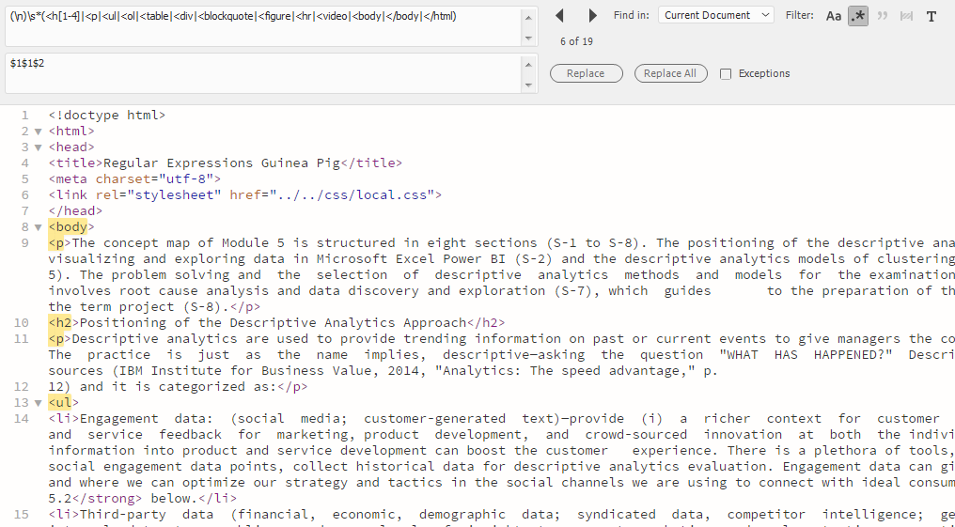
Demo
Enable regular expressions
CLICK

Slide 15
Demo
Enable regular expressions
(\n)\s*(<h[1-4]|<p|<ul|<ol|<table|<div|<blockquote|<figure|<hr|<video|<body|</body|</html)
CLICK

Slide 16
Demo
Enable regular expressions
$1
(\n)\s*(<h[1-4]|<p|<ul|<ol|<table|<div|<blockquote|<figure|<hr|<video|<body|</body|</html)
CLICK

Slide 17
Demo
Enable regular expressions
$1
Account for any white space before tag
(\n)\s*(<h[1-4]|<p|<ul|<ol|<table|<div|<blockquote|<figure|<hr|<video|<body|</body|</html)
CLICK

Slide 18
Demo
Enable regular expressions
$1
$2
(\n)\s*(<h[1-4]|<p|<ul|<ol|<table|<div|<blockquote|<figure|<hr|<video|<body|</body|</html)
CLICK

Slide 19
Demo
Enable regular expressions
$1
$2
(\n)\s*(<h[1-4]|<p|<ul|<ol|<table|<div|<blockquote|<figure|<hr|<video|<body|</body|</html)
$1$1$2
CLICK

Slide 20
Demo
Let’s see it in action
Enable regular expressions
$1
$2
(\n)\s*(<h[1-4]|<p|<ul|<ol|<table|<div|<blockquote|<figure|<hr|<video|<body|</body|</html)
$1$1$2

Slide 21
Objectives
Understand advantages of regular expression (regex or regexp) pattern matching over conventional find & replace
List regex literal characters
Differentiate among wildcards
Be able to build simple regular expressions to use in find / replace in Dreamweaver

Slide 22
Questions

